Slide 1
DIGITAL CITIZENSHIP | GRADE 8
Social Media and Digital Footprints: Our Responsibilities

Slide 2
Essential Question
How does using social media affect our digital footprint?

Slide 3
Learning Objectives
l
Identify reasons for using social media and the challenges that often come along with it.
Reflect on what responsibilities they have related to digital footprints—both their own and others'—when using social media.
Identify ways to make the most of social media while still caring for the digital footprints of themselves and others.
2
3

Slide 4
WARM UP: REFLECT
How would you describe your experiences with social media, either for yourself or for people you know? Good, bad, or in the middle? Why?
Directions:
Take a moment to think silently about this question.
Then, capture your ideas on the blank sheet.

Slide 5
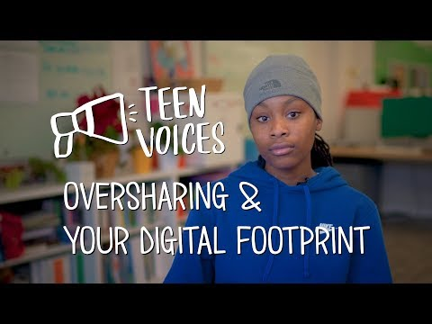
WATCH + DISCUSS
Discuss:
What viewpoint in the video do you agree with, and why? (Be specific.)
What are some of the drawbacks of social media use that teens brought up?
To watch this video on the Common Sense Education site, click here.

Slide 6
KEY VOCABULARY
Oversharing
When people share something they later regret

Slide 7
KEY VOCABULARY
Digital footprint
All the information online about a person either posted by that person or others, intentionally or unintentionally

Slide 8
ANALYZE: RESPONSIBLE SOCIAL MEDIA
The Rings of Responsibility

Slide 9
ANALYZE: RESPONSIBLE SOCIAL MEDIA
What responsibilities do you have to your self when you use social media? How can you be responsible for your own digital footprint?
Directions:
Take a minute to reflect on the question above.
The teacher will choose one person to share first. They'll have one minute to share out.
They'll pass clockwise to the left, and the next person will have one minute to share. This will continue in a circle until everyone has shared.

Slide 10
ANALYZE: RESPONSIBLE SOCIAL MEDIA
What responsibilities do you have to others when using social media? How can you be responsible for others' digital footprints?
Directions:
Take a minute to reflect on the question above.
The teacher will choose one person to share first. They'll have one minute to share with the group.
They'll pass clockwise to the left, and that person will have one minute to share. This will continue in a circle until everyone has shared.

Slide 11
WRAP UP: EXIT TICKET
Write down one example you would like to use in your own life around being responsible for your own digital footprint … or the footprints of others.

