Slide 1
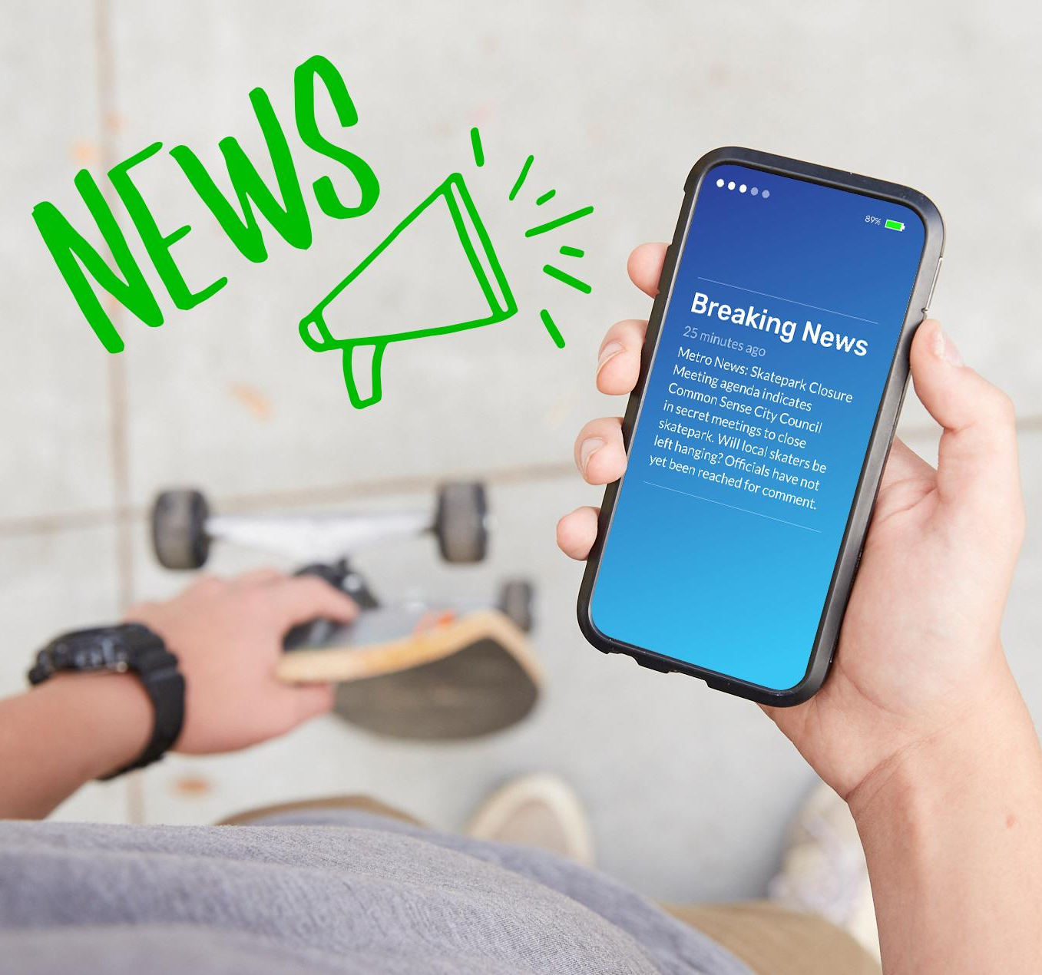
DIGITAL CITIZENSHIP | GRADE 8
This Just In!

Slide 2
Essential Question
How should we react to breaking news?

Slide 3
Learning Objectives
l
Define breaking news and understand why individuals and news outlets want to be first to report a story.
Analyze breaking news alerts to identify clues of false or incomplete information.
Reflect on the consequences of reacting right away to breaking news alerts.
2
3

Slide 4
WARM UP: REFLECT
Have you ever seen a breaking news alert like this one?
How did/does it make you feel?
Notes:
https://www.maxpixel.net/Breaking-News-Urgently-The-Gap-Message-News-Alarm-2310064

Slide 5
Breaking news
KEY VOCABULARY
Information being reported about an event that has just happened or is currently occurring

Slide 6
ACTIVITY: CLASS DISCUSSION
What are the benefits of being the first to "break" news?
For Individuals | For News Outlets

Slide 7
24/7 News Cycle
KEY VOCABULARY
24-hour, seven-day-a-week investigating and reporting of news via television, radio, print, online, and mobile app devices

Slide 8
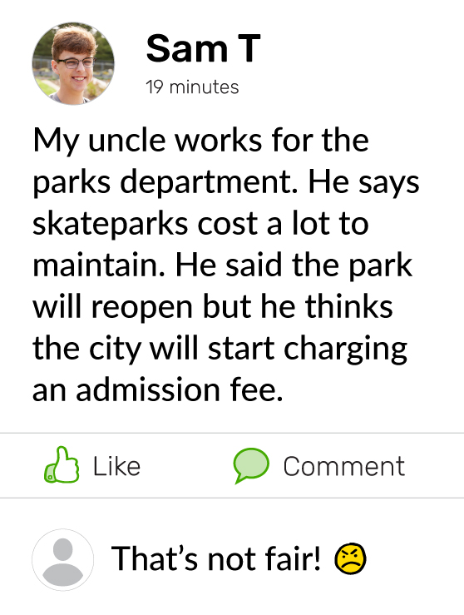
ACTIVITY: BREAKING DOWN BREAKING NEWS

Slide 9
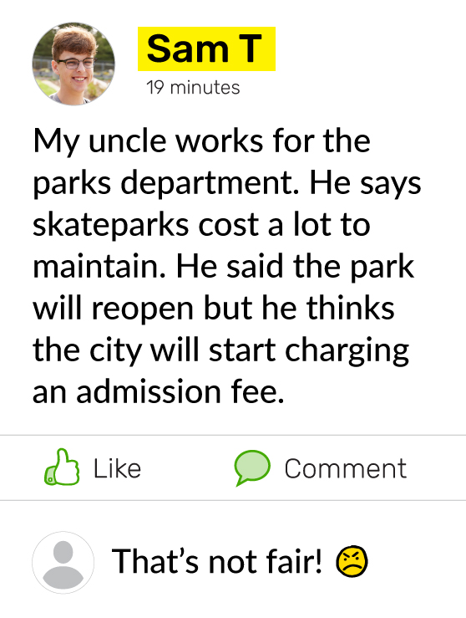
ACTIVITY: BREAKING DOWN BREAKING NEWS
Alerts No. 2 and 3 are not from established news organizations. News organizations follow professional standards and practices to verify news reports and make corrections when they get facts wrong.
Alert No. 3 is presenting the story in a particular way, as if it is connected to something that happened several years before. The author of this post wants people to believe that their rights are being taken away. This is an example of bias.
Alert No. 1 uses words and phrases that show there's likely more information to come.

Slide 10
Bias
KEY VOCABULARY
Showing a strong opinion or preference for or against something or someone

Slide 11
ANALYZE: CRITICAL EYE FOR BREAKING NEWS TIPS
Before reacting, slow down and ... Check the source. Is the news from a reliable news organization? If not, it may be questionable. See if other news organizations are reporting the same thing. Look to see if there's more information to come. Does the article mention important details that aren't yet known? If so, it may be better to wait for the whole story before deciding what to think or sharing. Analyze for bias. Does the author or source organization have an agenda or purpose for talking about the story? If so, look for a different source.

Slide 12
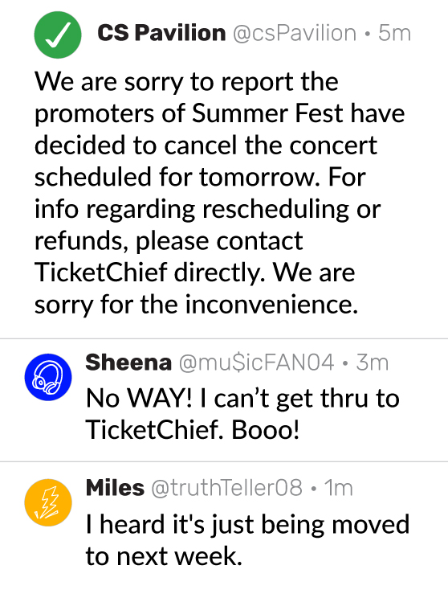
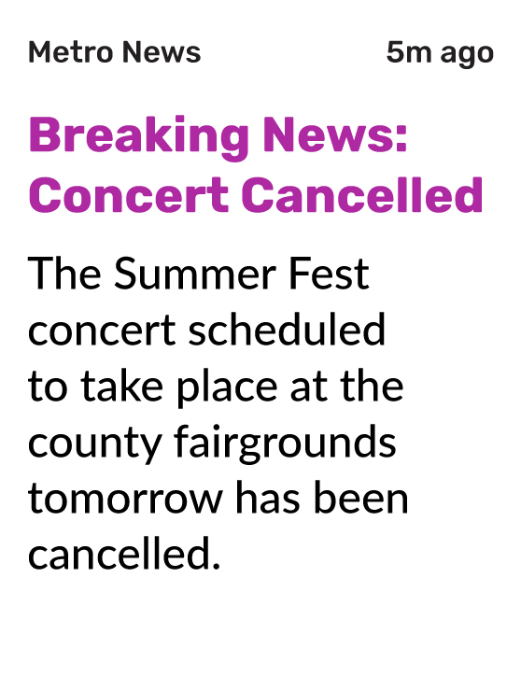
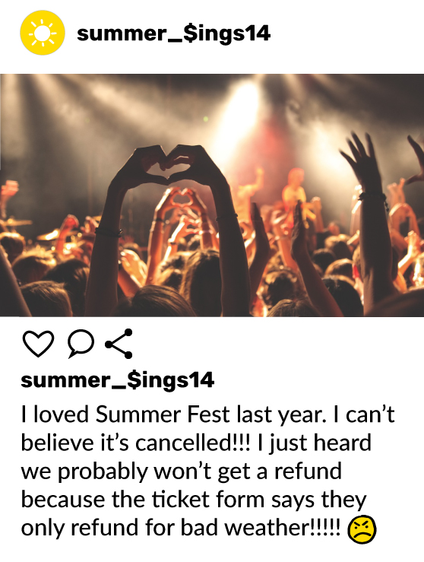
ACTIVITY: CANCELED CONCERT?

