Slide 1
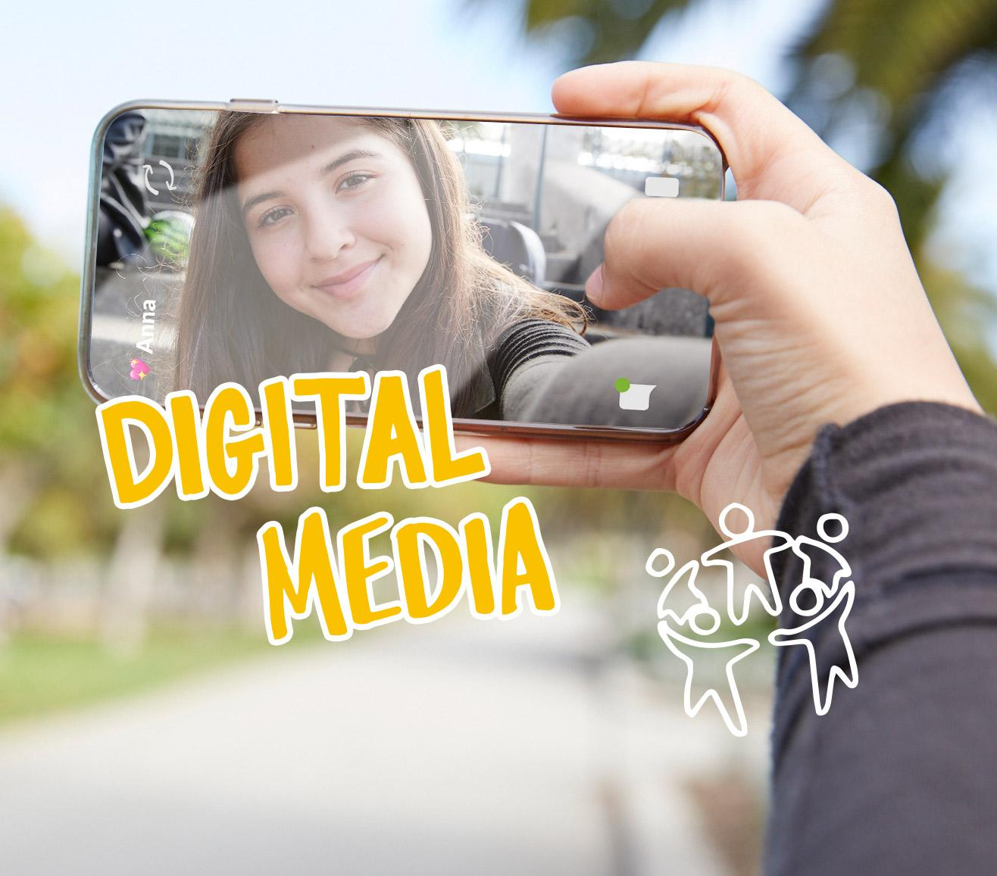
DIGITAL CITIZENSHIP | GRADE 9
My Digital Life Is Like ...

Slide 2
Essential Question
What is the role of digital media in our lives?

Slide 3
Learning Objectives
l
Explore the role that digital media plays in your life.
Use the Digital Habits Checkup to reflect on the positive and negative impacts of digital media.
Create a personal challenge to improve your digital well-being.
2
3

Slide 4
KEY VOCABULARY
Media balance
Using media in a way that feels healthy and in balance with other life activities (family, friends, school, hobbies, etc.)

Slide 5
KEY VOCABULARY
Digital media
Content (text, audio, images, video) or devices that allow people to share information, communicate, and collaborate over the internet or computer networks

Slide 6
KEY VOCABULARY
Simile
A figure of speech in which comparison is made between two different things using the words "like" or "as"

Slide 7
ACTIVITY: DIGITAL LIFE SIMILE
Part 2 Examples
Digital life similes:
My digital life is like a window on the world, because it allows me to see all kinds of new things and imagine other possibilities.
My digital life is like a roller coaster, because it's exciting and full of ups and downs.
My digital life is like a party where I meet a lot of different people, because it feels loud, out of control, and yet fun.

