Slide 1
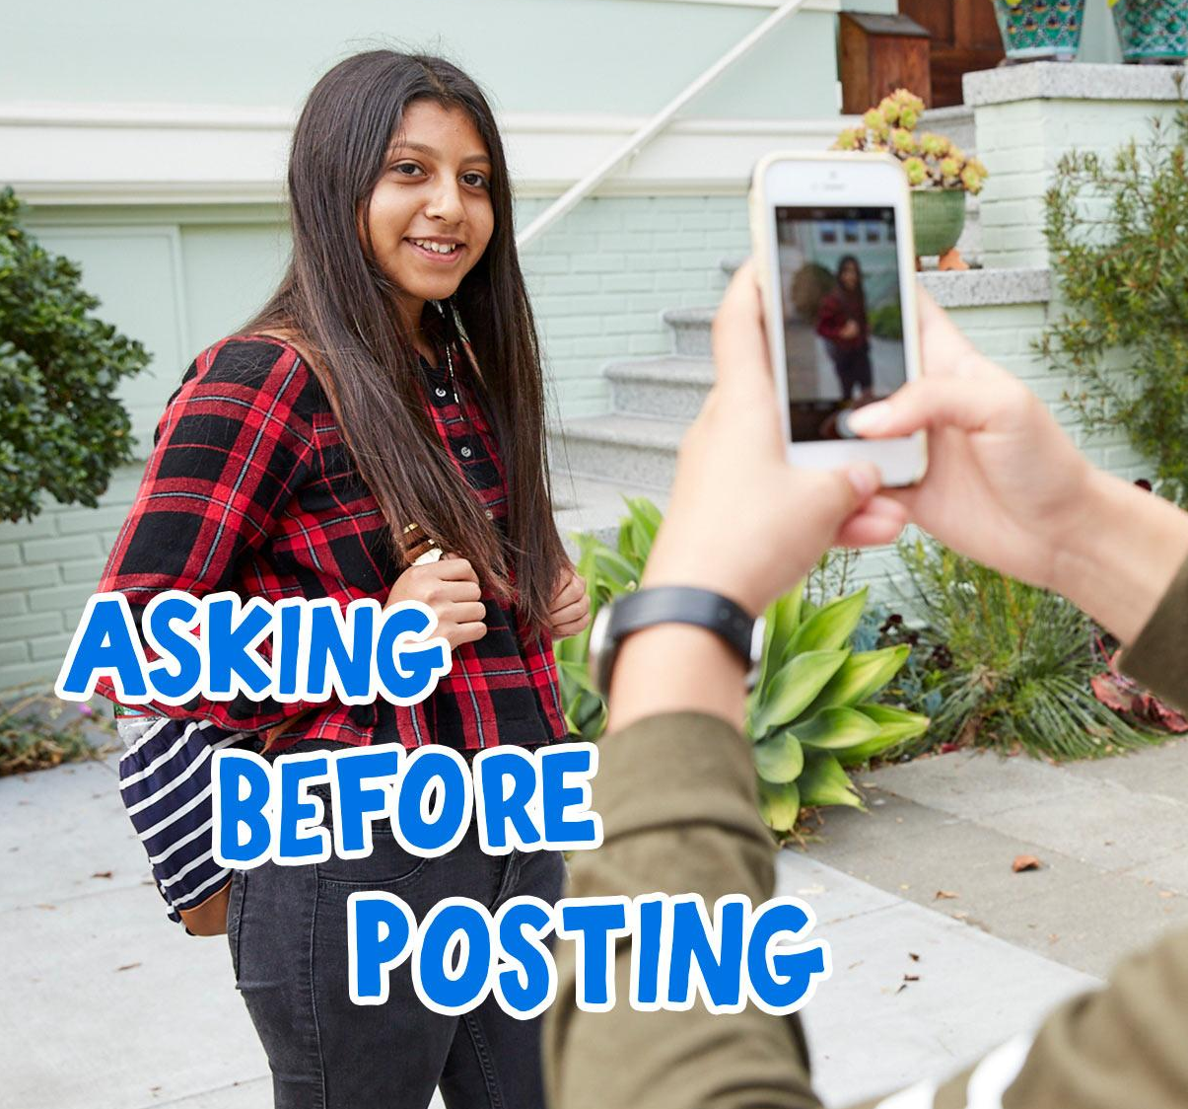
DIGITAL CITIZENSHIP | GRADE 9
Protecting Online Reputations

Slide 2
Essential Question
How can you respect the privacy of others online?

Slide 3
Learning Objectives
l
Define digital reputation, and identify examples of social media posts that can have a positive or negative effect.
Use the 1-2-3-1 Perspectives activity to consider the causes and effects of posting about others online.
Generate a list of questions to ask themselves before posting pictures or information about someone else.
2
3

Slide 4
KEY VOCABULARY
Sharenting
When parents or caregivers post excessive or sensitive details about children's lives online

Slide 5
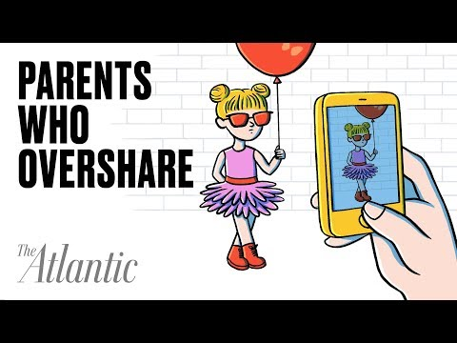
WATCH + DISCUSS
Discuss:
What are the upsides and downsides to sharing posts, photos, and videos of children online?

Slide 6
KEY VOCABULARY
Digital footprint
All the information online about a person either posted by that person or others, intentionally or unintentionally

Slide 7
KEY VOCABULARY
Digital reputation
What people think about you based on what they see online (social media, public information, news, etc.)

Slide 8
Good for digital reputation | Not so good for digital reputation

Slide 9
ACTIVITY: PERSPECTIVES ON POSTING
Part 1 Directions
In your group, review and analyze the scenario below using the 1-2-3-1 Perspectives activity.
1 perspective (yours)
2 perspectives (others)
3 ideas
1 way forward

Slide 10
ACTIVITY: CLASS DISCUSSION
What did you decide was the best way forward? Why?
Directions:
Close your computer halfway.
Track the speaker and practice active listening.
If you need to refer to your notes, check your screen quickly and then close it halfway again.

Slide 11
Reputation Protection
Questions to Ask Before Posting
Reputation Protection
Questions to Ask Before Posting
[Capture student responses here.]

